Slide 1
Twitter Sentiment Analysis & Prediction
Presented by:
Team Cyberbots

Slide 2
Agenda of the Presentation
Business problem and impact
Evaluation metric used
About the data
First set of visualisations
Data pre-processing
Machine Learning - Models and approaches
Model tuning
Evaluation and results
Final results
Insights
Next steps and future steps

Slide 3
Business Problem
Increase the click to conversion rates of the startup products
To increase the ROI on the marketing campaign of the startup product ,by increasing its social media presence, from a benchmark value generated by conventional marketing

Slide 4
Evaluation metric used
Weighted F1 Score
sklearn.metrics.f1_score(y_true, y_pred , average=’weighted’)
The F1 score can be interpreted as a weighted average(harmonic mean) of the precision and recall.
F1 score reaches its best value at 1 and worst score at 0. The relative contribution of precision and recall to the F1 score are equal. The formula for the F1 score is:
F1 = 2 * ( precision * recall ) / ( precision + recall )

Slide 5
About the data
Given : evaluated tweets about multiple brands
The evaluators(random audience) were asked if the tweet expressed is positive , negative , or no emotion towards a product/ brand and is labelled accordingly
Dataset has 7273 tweets with the sentiment label
3 columns:
Tweet_id : unique id for tweets
Tweet : tweet about the brand / product
Sentiment : 0 : negative, 1 : neutral, 2 : positive, 3 : can't tell

Slide 6
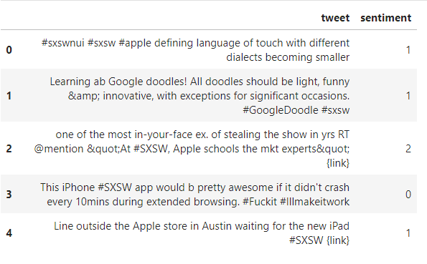
Dataset at a glance

Slide 7
1
FIRST STEPS EDA
Let’s start with the first set of Visualizations

Slide 8
What is SXSW?
South by Southwest Interactive conference is an event known for giving tech trends the momentum to hit the masses.
The event takes place every year in mid-March in Austin, Texas, United States and is recognized as a testing ground for emerging social apps and technologies.
The show has developed a reputation as a tech launch pad, thanks to two spectacular case studies: Twitter and Foursquare.
Twitter had been around for nine months by the time SXSW 2007 opened, but its user base skyrocketed after the show
Two years later, location-based networking service Foursquare pulled off a similar trick, launching its check-in service at SXSW 2009

Slide 9
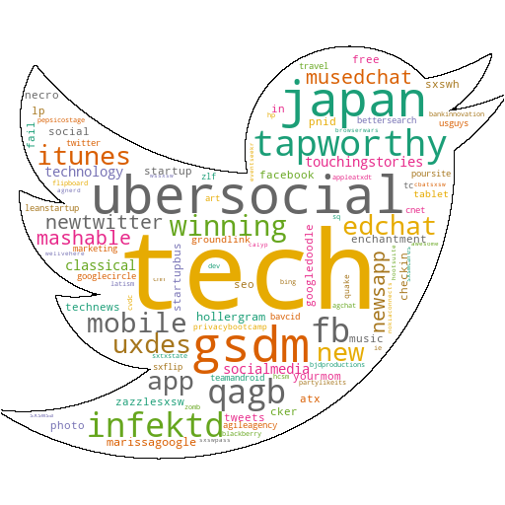
Top Hashtags at SXSW 2011
New UberSocial app was launched for iphone with UberGuide to #sxsw feature in partnership with mashable which included topic streams and also allowed people who couldn’t make it Austin a sense being a part of this amazing event.
qagb –Questions and answers session held by Google and Bing on Website Ranking and SEO
Gsdm -Advertising Agency in Austin held an industry party co-hosted with google

Slide 10
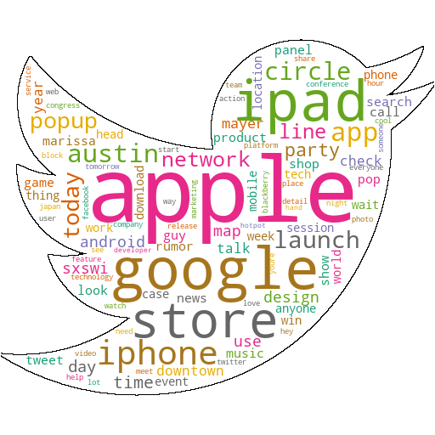
Tweets at SXSW 2011
Apple and Google were the most talked about brands at SXSWI 2011
Apple launched the Ipad 2 at the event and had set up a popup store to cater to the crowds.
There was a lot of anticipation around Google launching its social network app Google Circles to compete with Facebook.
Google's Marissa Mayer gave a talk on the future of location: augmented reality, contextual discovery, making smartphones smarter.

Slide 11
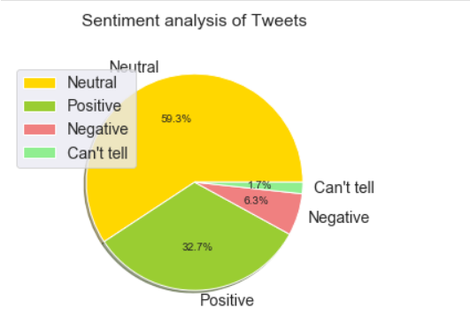
Sentiment distribution across tweets
Out of 7273 tweets for the SXSW event around 4311 were neutral which was around 60%.
Around 2382 tweets were positive around 32.7%.
456 tweets had been negative which were around 6.3%.
And for 125 tweets, the sentiment could not be predicted.

Slide 12
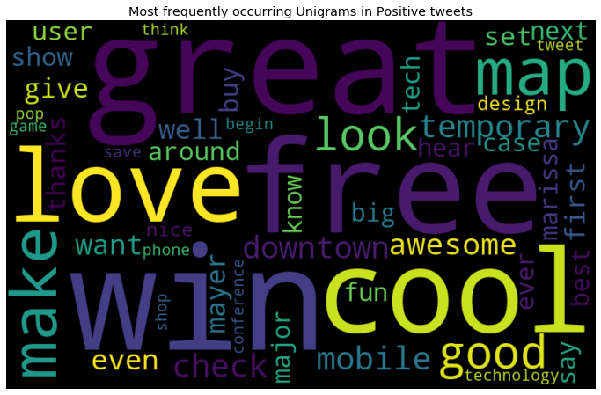
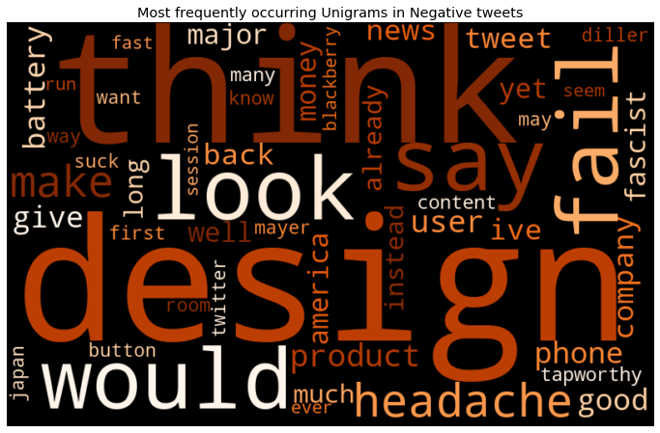
Positive & negative words
By the time of this event, 40% of google maps usage was through mobile phones.
People were mostly not happy with the design and battery.

Slide 13
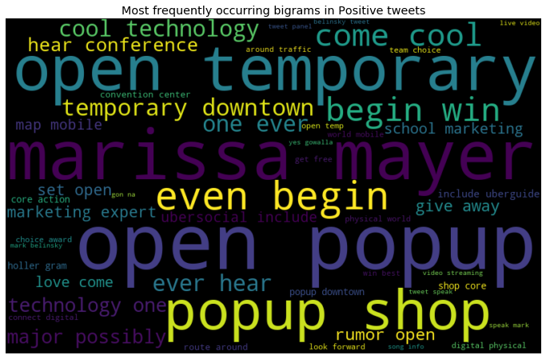
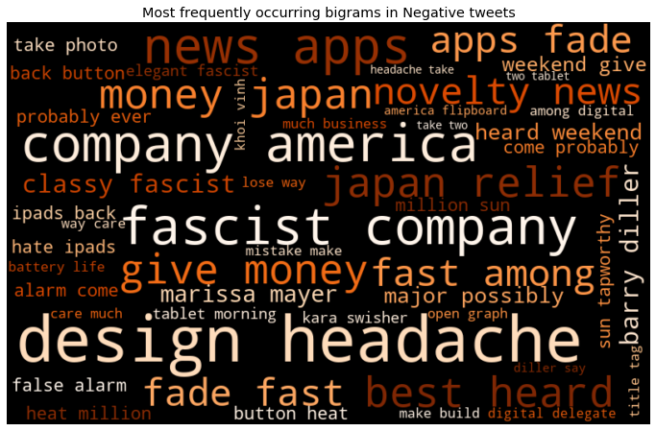
Positive and negative bigrams
Apple’s popup store to sell iPad2 generated a lot of positive buzz at the event.
Fascist Company - Apple seems to want to be able to control every aspect of how we engage with the virtual. This was disliked by a lot of users.

Slide 14
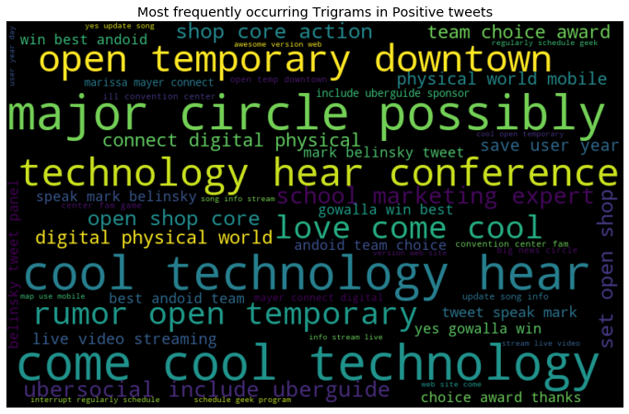
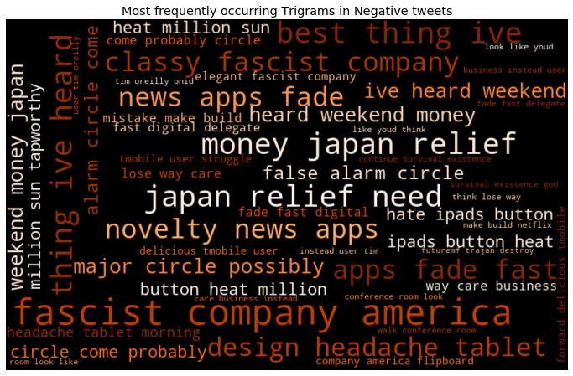
Positive and negative bigrams
Gowalla- a Geosocial networking app won the best Android app at the Team Android Choice Awards
Many attendees were deeply affected by the Japan crisis and considered donating the money instead of buying an ipad2.

Slide 15
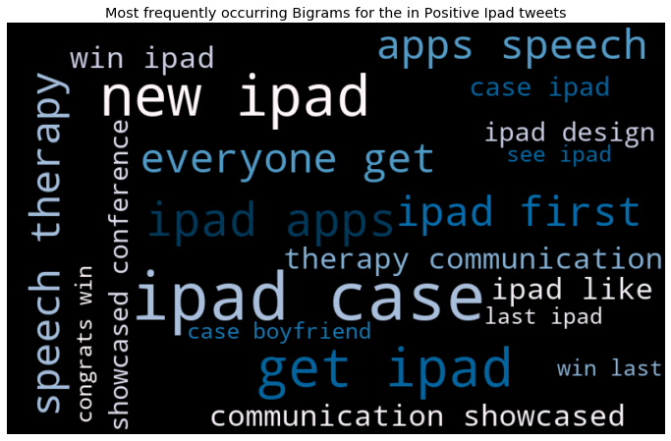
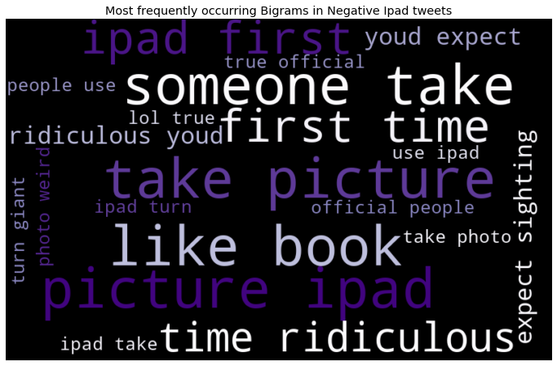
Ipad2 sentiment analysis
New iPad apps were launched for speech therapy and was liked by the attendees.
Many attendees were unhappy with the iPad 2 camera.

Slide 16
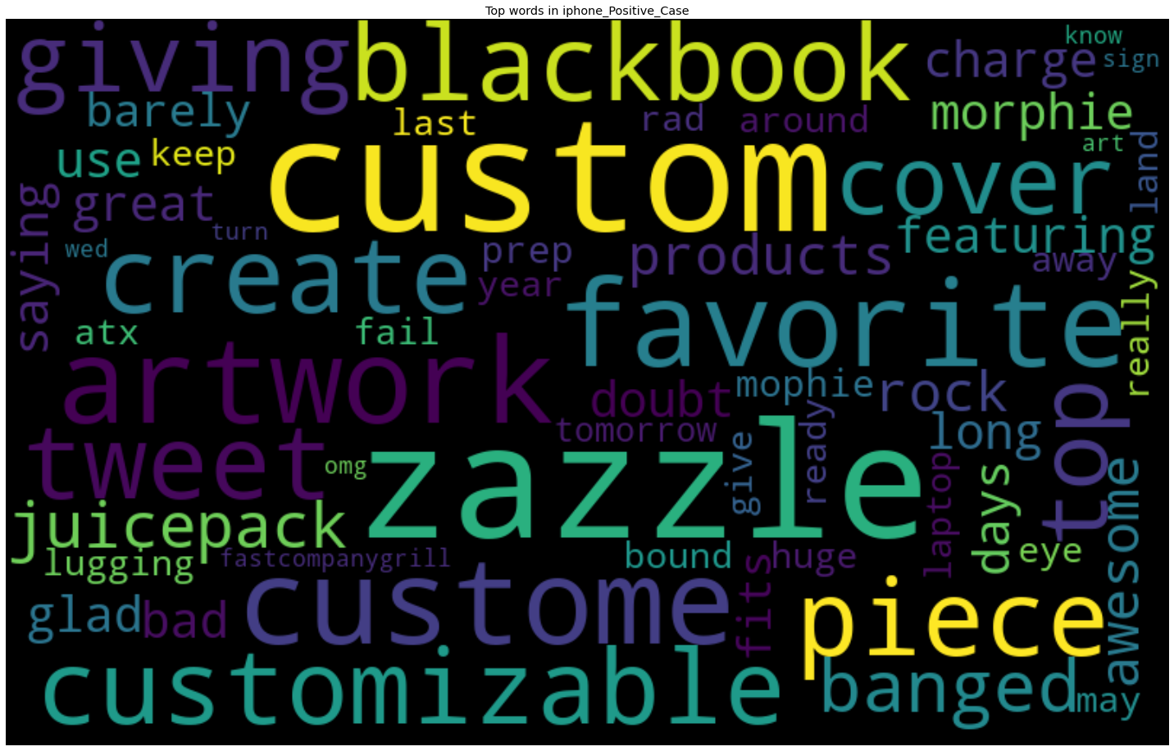
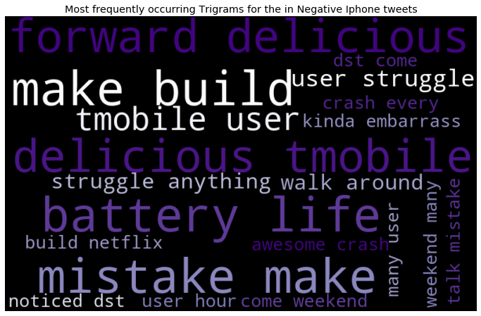
Iphone sentiment analysis
Customizable cases for iPhone
Battery Issues on iPhone

Slide 17
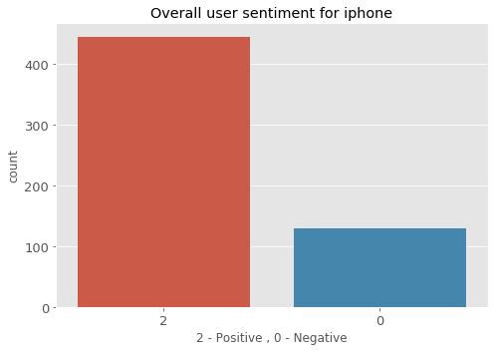
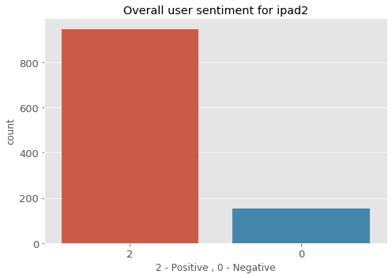
Iphone & Ipad Sentiment at the event
For iPad : 86% of the tweets were positive and 14% of them were negative.
For iPhone : 77% were positive and 23% of them were negative.

Slide 18

Data pre-processing steps
Only one null value for tweet , dropped it.
No duplicate data
Converted entire tweets to lower case
Removed user handles and RT
Removed URLs
Removed Stop words, Punctuation and Digits.
Handled negative words(isn’t to is not)
Chat words conversion/slangs (fyi – for your information)
Replacing emoticons & emojis with words.
Lemmatization with POS tags.

Slide 19
Modelling
For Model Fitting and Prediction we tried classification models like
Logistic Regression, Linear SVC, Naïve Bayes and Random Forest were the models applied on data
We used Feature Extraction techniques
Handle Imbalanced Data we tried
- Count Vectorizer
-TFIDF Vectorizer
-Hashing vectorizer
SMOTE /random oversampling techniques

Slide 20
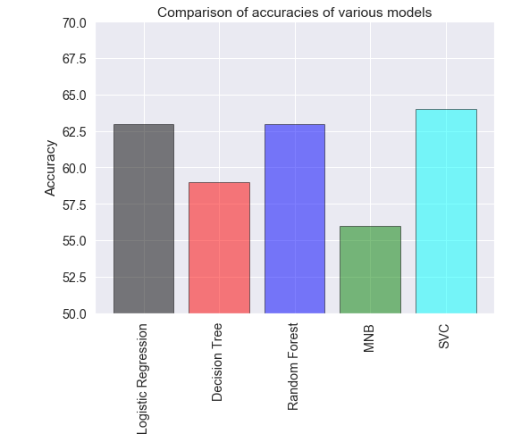
We generated baseline score for these models, svc gave the highest at 63

Slide 21
Model Scores
Model | Weighted F1 Score
Logistic Reg with TF-IDF | 0.627
Logistic Reg with Count Vect. | 0.653
Logistic Reg with Hashing Vect. | 0.613
SVC with TF-IDF | 0.636
Then we used SMOTE / Random over sampler on our chosen model:
Model chosen: Logistic Reg with Count Vect
Accuracy decreased by 22% from
0.8 to 0.62
F1 score underwent no major change

Slide 22

After baseline model we tried hyperparameter tuning
Model | Weighted F1 Score | Best Parameters
LinearSVC with RandomizedSearchCV | 0.656 | {'penalty': ‘L2', 'max_iter': 1000, 'C': 0.8}
LinearSVC with GridSearchCV | 0.603 | {'C':1.2, 'max_iter': 150, 'penalty': 'l2'}
Random Forest Classifier | 0.606 | {'n_estimators': 10, 'max_features': 100, 'max_depth': 60, 'criterion': 'gini', 'bootstrap': 'False'}

Slide 23
Explanations on modelling:
Target imbalance treatment by using SMOTE / Random oversampling techniques
Model chosen is Logreg with count vectorisation.
no major changes in F1 Score but accuracy dropped by 22% from 0.8 to 0.62.
Hyper parameter tuning done in Linear SVC since it gave highest f1 score.
Used linear kernel because data set is pretty small , didn't require high dimensional kernels like rbf.
Can use polynomial kernel for better multi classification with non linear hyper planes
Best parameter chosen by model is penalty= L2 (ridge regression).
Since this not a sparse data as NAN values are negligible therefore didn't require L1 regularisation.
C= trade-off value between smooth decision boundary and classifying the training parts correctly.
Increase in C value may lead to over fitting the model , therefore tried the c value over a range of 5 values from 0 to 1.2, best value chosen was 0.8.
Didn't use gamma parameter in svc since this is a linear svc model, gamma is a parameter on non linear hyper planes.
Best value of C can be found using RandomisedSearchCV and GridsearchCV,
Here randomised search CV on linearSVC gave a higher f1 score.

Slide 24
Actionable Insight
SXSW is a tech launch pad. Participating in similar events like linkedin talent connect , adobe summit will help garner huge industry knowledge for the startups
Organise industry meetup or partyn conduct some tech sessions there , so that the company and to some extent the product will be in the trending list of the tech world which would surely augment the global recognition of the product as well as the company.
marketing strategies of tech giants like apple and Google are highly effective , follow them closely and publicise about companies idea on , linkedin prior to such events. It will definitely hype up anticipation among people about the company.
faith has to be created in public about the product ,Learn from the negative reviews of other similar kind of products participated in such events to avoid such mistakes,making mistakes again and again and learning from them is not a wise decision, because it hampers the public image

Slide 25
Future work to be done on this sentiment analysis project done
Handling emotion of the tweets with increased ranges
Using symbols
Building a classifier for Hindi tweets
Improving Results using Semantics Analysis
Graph Analytics can be used to better understand the twitter user’s network
Create a GUI

Slide 26
THANKS!

